Slide 1
April 28, 2021 Work Group Update

Slide 2
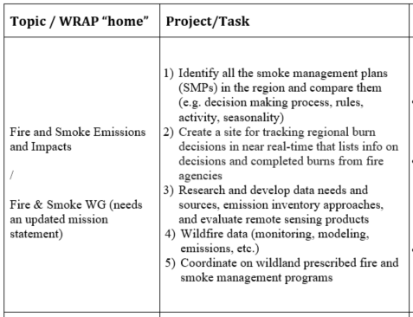
Fire & Smoke Work Group Progress Update 12/1/2020 Board Approved Work Topics
April 2021
Presented WG update at WESTAR WRAP Spring Business meeting
WG had 1 call – 4/19/21
Presentation on Utah Smoke study – posted on web page
Update on conceptual model project – see TSC update in this meeting
Membership survey results –
18 responses
‘critical mass’ for 4 topical teams
addressing several board approved work topics
Teams will meet to discuss next steps
Next call – May 24

Slide 3
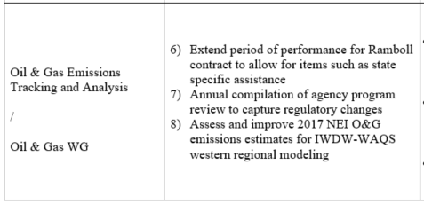
Oil & Gas Work Group Progress Update 12/1/2020 Board Approved Work Topics
April 2021
“2021 OGWG Workplan Scope” meeting to be scheduled in mid-to late May

Slide 4
Regional Technical Operations Work Group Status Update April 2021
Tasks / Coordination / Meetings
Updates to TSS with recent model results/analyses
Delivery of CAMx source apportionment run: state-specific source group visibility contributions
4/1 - Methodology for 2028OTBa2 State-Specific Source Group Visibility Source Apportionment Modeling, presentation by Ramboll to WRAP Regional Haze Results Meeting #8
4/7 - Review SD Questions on Regional Haze TSS Modeling Results
4/26 - 2017 GEOS-Chem modeling & WRF modeling tasks’ progress report meeting
4/27 - Discussion of normalization of Regional Haze SA results
Preparation of Review of Methodology for Modeled Anthropogenic Glidepath and Dynamic Modeling Evaluation for WRAP 2002hindcast / RepBase2 / 2028OTBa2 Modeling by Ramboll for 5/5 Regional Haze Results Meeting

Slide 5
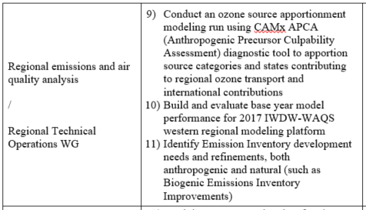
12/1/2020 Board Approved Work Topics RTO Work Group Progress Update
(No change from previous TSC/WG call)
Discuss with RTOWG to refine work topics
Update Workplan Scope
Kickoff call
Topical discussion / roundtable
Internal and External coordination / topics
Coordination with contractor
Work Group calls – soon, maybe in May

Slide 6
Regional Haze Planning Work Group Status Update April 2021
Modeling Results Meetings
April 1st
Upcoming May 5th
State-State coordination call
April 13th
No RHPWG specific meeting planned

Slide 7
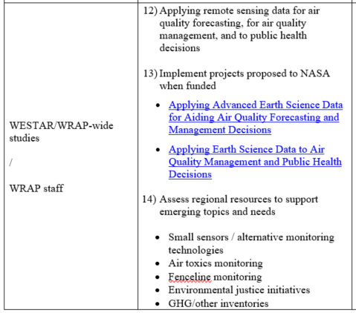
WESTAR/WRAP Progress Update 12/1/2020 Board Approved Work Topics
April 2021
#12-13 – to be combined under 2 new project funding proposals to NASA
NNH21ZDA001N-HAQ:A.37 Earth Science Applications: Health and Air Quality
Notice of Intent (1-2 paragraphs) due April 30th
Full proposal due June 18th
Funding up to $250-$300k/year for 3 years
Applying Remote Sensing Data to construct a Wildland Smoke Emissions Data Warehouse (ARSD-WSEDW)
To build / implement FSWG Conceptual Model for Fire Data
WESTAR-WRAP managed, work by Air Sciences (science data design), Michigan Tech Research Institute (emissions tools), and CSU-CIRA (warehouse)
Tailoring Science Data from High-resolution Satellites and Models to Improve Decision Support Systems for Air Quality Management Applications
Address gaps between Earth Science data and routine evaluation and application by air quality management agencies for regulatory analysis and decision-making activities
Co-managed by University of Alabama in Huntsville and WESTAR-WRAP, leveraging inputs from experts at air agencies in the West and WESTAR-WRAP Work groups
#14 – no change, awaiting policy / implementation strategies from Biden EPA
#16 – plan is have Tom and Jay Baker help states with questions in SIP submittal and EPA review process, no plans for other contracted support
WESTAR-WRAP will maintain operating agreement with CSU-CIRA for TSS / IWDW

